Slide 1

Course Management System
By: Lina Alameh 112967
Info-439

Slide 2
Outline
Introduction
Users Types and Features
Front-End
Back-End
Security Features
Testing

Slide 3
Introduction
Development of a university website to manage course registration
Easy-to-use interface

Slide 4

Introduction
Development of a university website to manage course registration
2 types of user with different authority
Easy-to-use interface for both students and instructors
Front end: HTML, CSS, JS, bootstrap
Back end: PHP
DBMS: MySQL

Slide 5
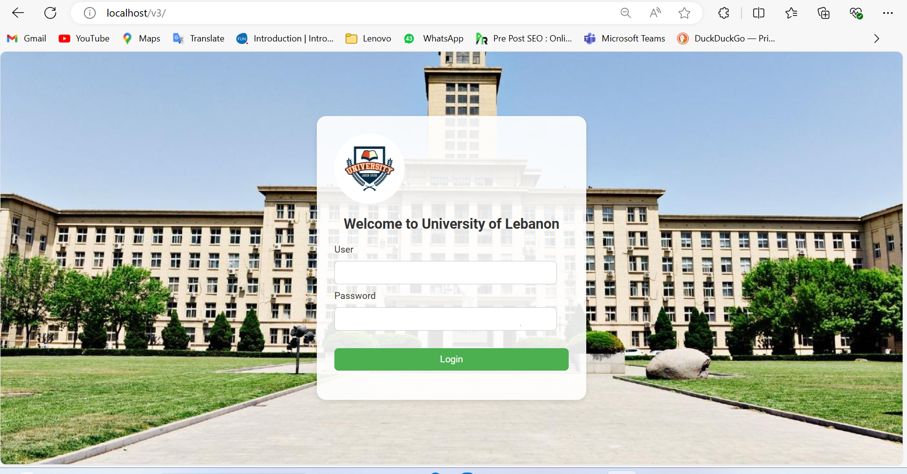

Slide 6
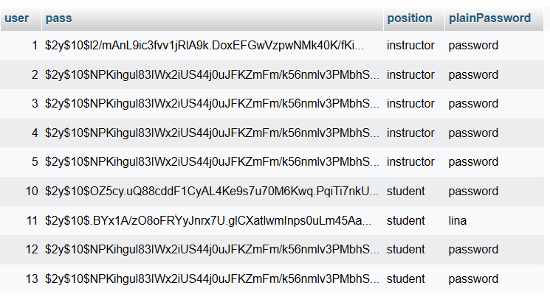
Based on the users position, a specific landing page will appear
1 for students, 1 for instructors

Slide 7

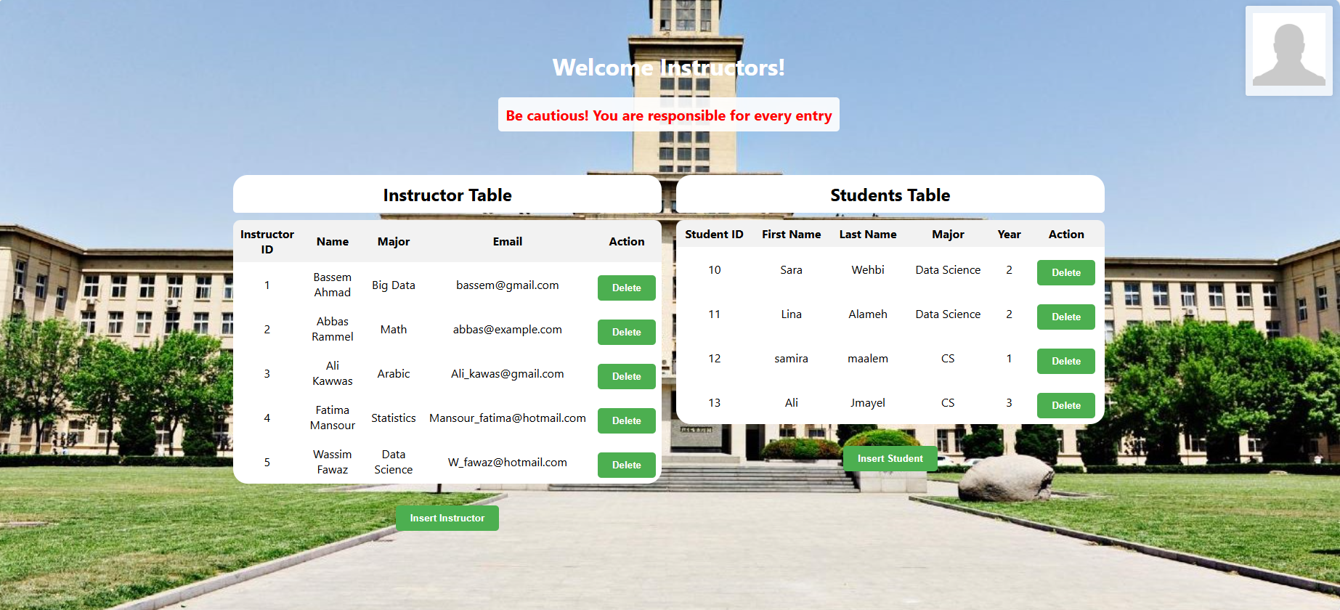
Students Landing page
Instructors Landing page

Slide 8

Users Types and Features

Slide 9
Students
Course Registration
Profile Management : Access personal information, and view academic progress.
Password Management:Securely change passwords to maintain account security.
Session Tracking: All user sessions are tracked for security and operational purposes.
Logout:Students can securely log out of their accounts to end their sessions.

Slide 11

1

Slide 12

2

Slide 13

3

Slide 14
Instructors
User Management/ account creation:Add new students and instructors to the system, facilitating user base expansion. remove users as needed.
Course Management:Register students for courses, ensuring correct enrollment. View and manage all courses offered by the university.
View Profiles and Course Data:Access detailed profiles of all users, including students and other instructors.
Password Management:Securely change passwords to maintain account security.
Session Tracking:All user sessions are tracked for security and operational purposes.
Logout:Instructors can securely log out of their accounts to end their sessions.

Slide 16

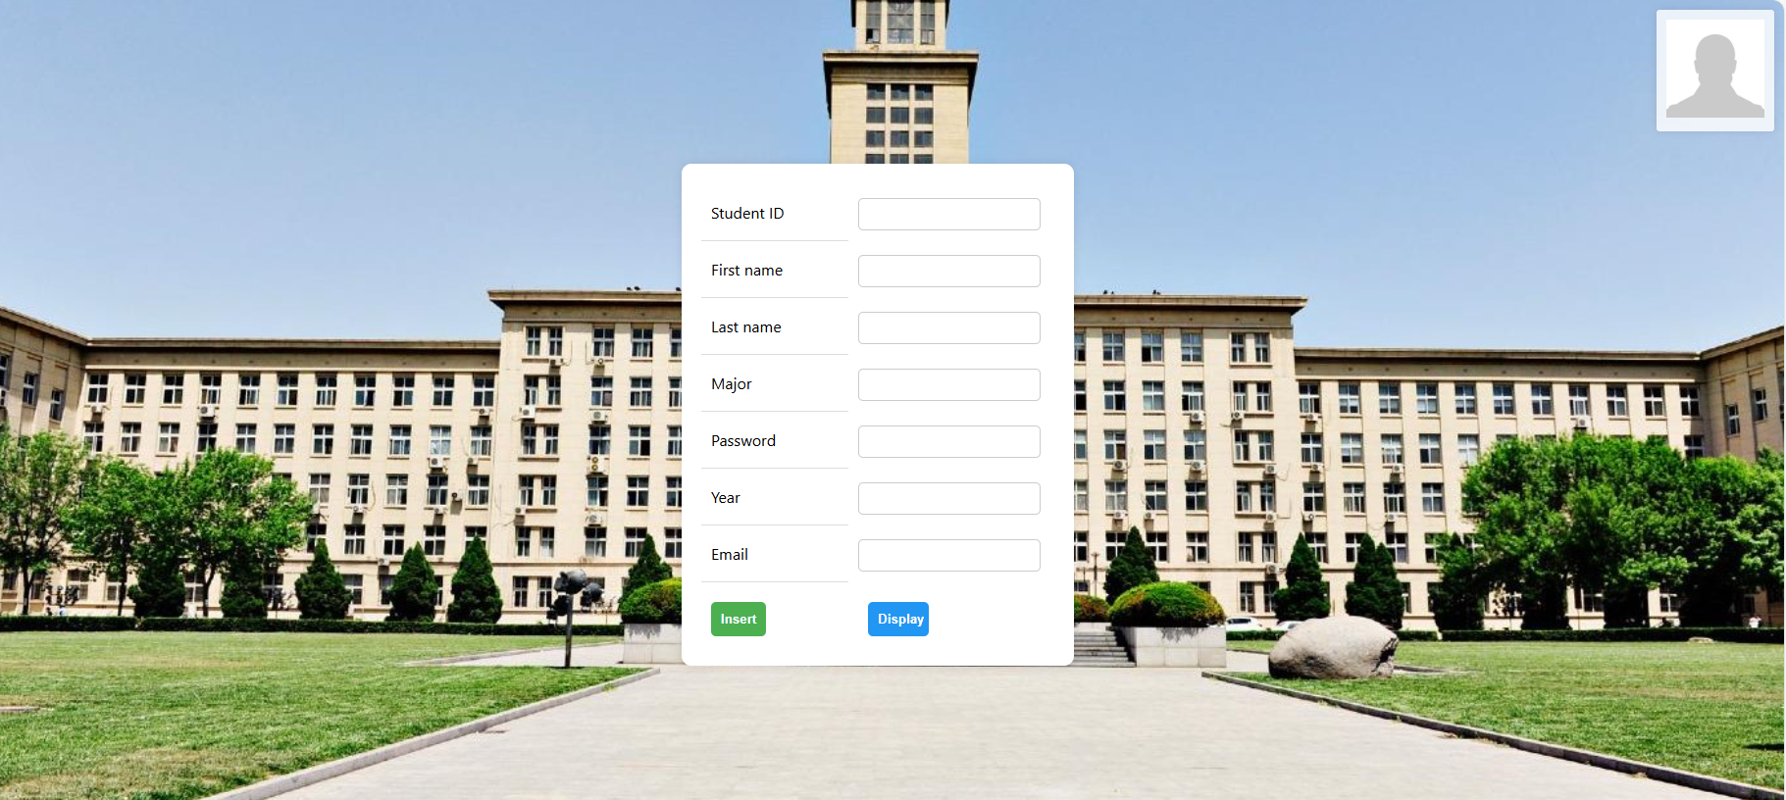
Form for instructor insertion
Form for student insertion

Slide 17

1

Slide 18
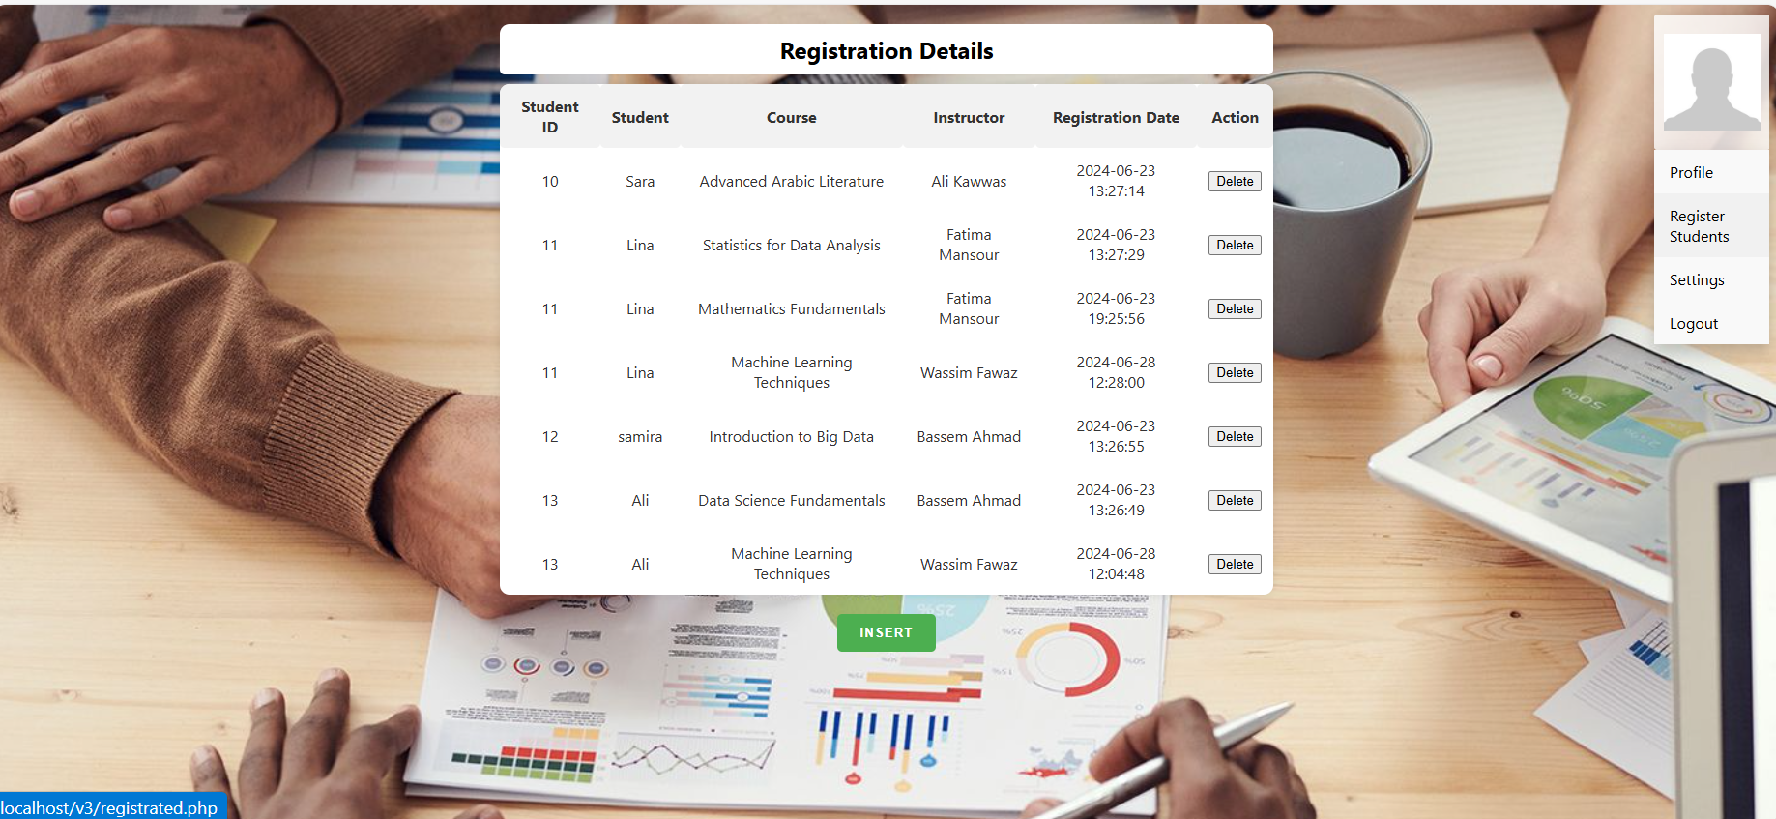
2

Slide 19


Slide 20

3

Slide 21
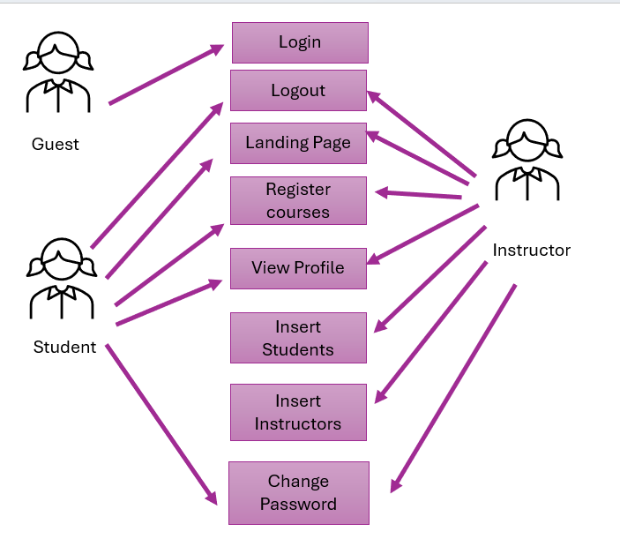
Use case diagram
View all profiles

Slide 22
Front end
•Language used: HTML, CSS
•CSS Integration: Each PHP file is linked with its dedicated CSS file for consistent and stylish page design.
•Unified Styling : Consistent modern styling is applied across all pages to enhance user experience and visual coherence.
•Bootstrap Utilization: Bootstrap components are leveraged for rapid integration of responsive and polished UI elements.
•JavaScript Validation: JavaScript enhances form functionality by providing real-time validation, ensuring accurate user input and feedback.

Slide 23
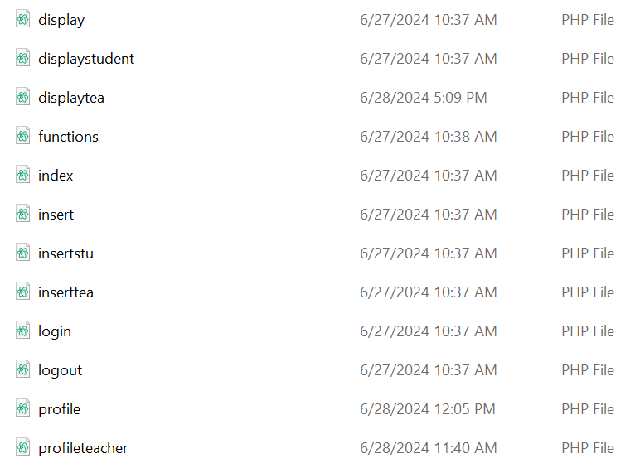
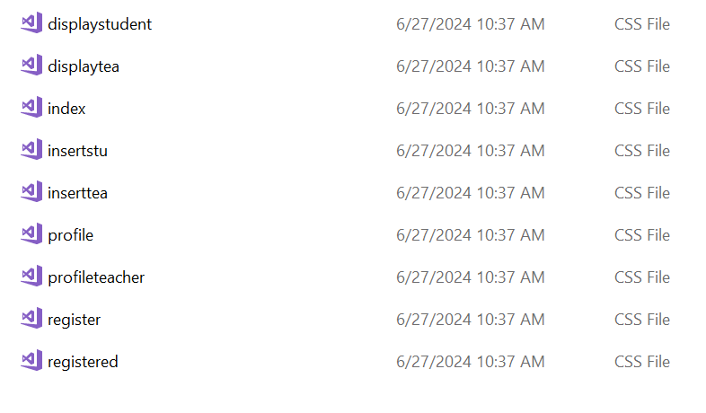
PHP --> CSS

Slide 24
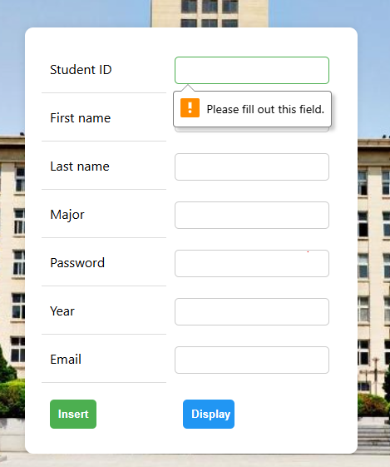
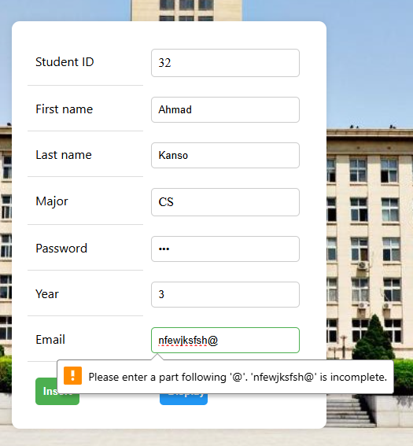
JavaScript Validation

Slide 25
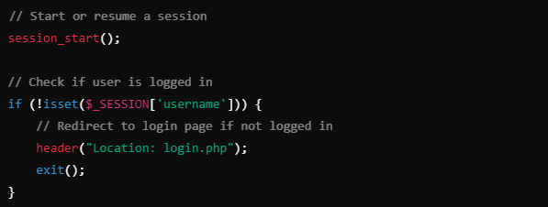
Backend dev
User Authentication:
PHP handles the authentication process when users log in. This typically involves validating user credentials (username and password) against stored data in a database.
Upon successful login, PHP sets session variables to keep the user logged in across different pages of the website until they log out or the session expires.
Session Management:
PHP manages user sessions to track logged-in users and maintain their state across pages. Sessions are typically stored on the server and identified by a unique session ID stored as a cookie on the client-side

Slide 26
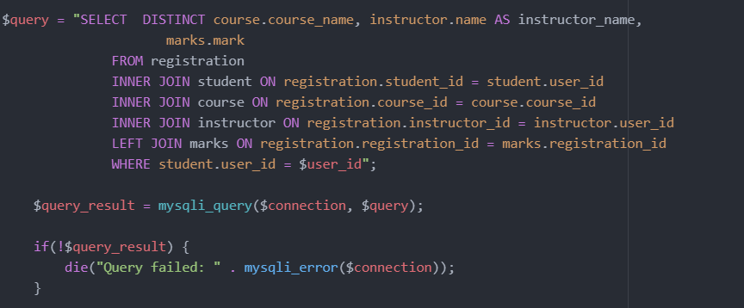
Database Operations
PHP interacts with the database to perform CRUD (Create, Read, Update, Delete) operations related to user management, course registration, and profile data.
Error Handling and Validation:
PHP handles form submissions, validates input data, and performs error handling to provide meaningful feedback to users and maintain data integrity.

Slide 27
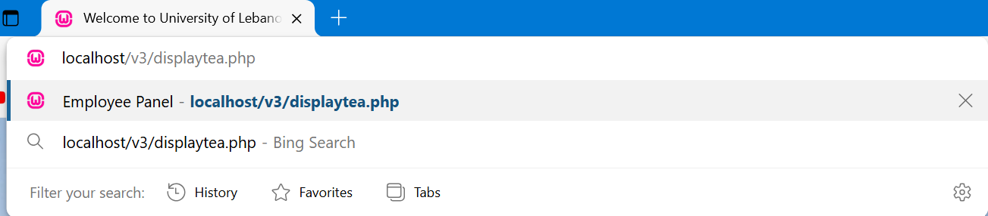
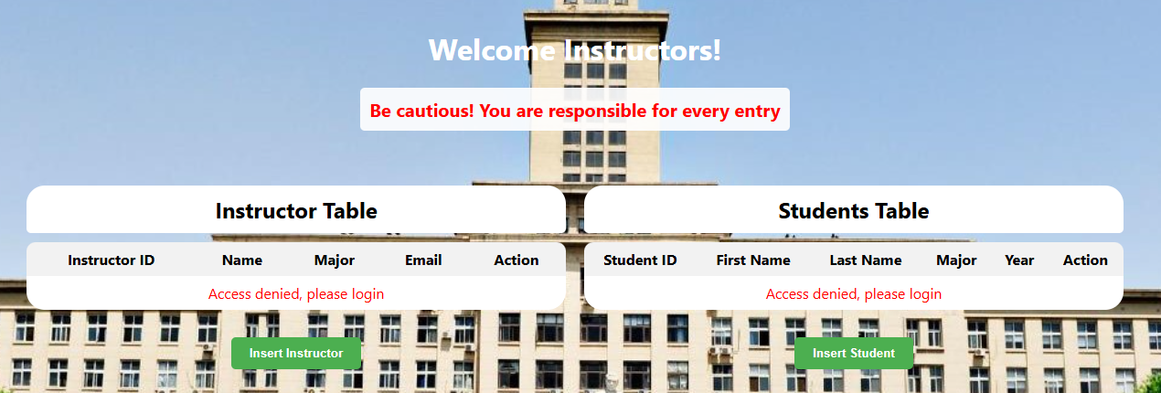
Security Features
Hash password
Session tracking

Slide 28
Testing and Debugging
Manual Testing

